Slide 1
CS6382 Algorithm Analysis and Game Theory: Facility Location games
Notes:
Hello, everyone. Today, I am going to talk about algorithmic mechanism design on cloud computing and facility location.

Slide 2
Algorithmic Mechanism Design
A mechanism M chooses a social outcome to maximize an objective regarding the information reported by agents;
All agents share the same public information and know M;
Each agent has his own private information s_{i} and is asked to report it to the mechanism,
S = (s₁ , . . . , s_{n}): agents’ private information;
R = (r₁ , . . . ,r_{n}): information reported by agents to the mechanism;
The mechanism chooses a social outcome O with regard to R;
Each agent has a valuation v_{i} on O.
Problem:
Each agent will manipulate his report (a.k.a strategy) in order to make the mechanism choose better outcome(s) for himself.
Notes:
In algorithmic mechanism design, a mechanism is designed to choose an outcome based on the information reported from agents. Often a mechanism chooses an outcome to optimize a objective.
And we assume that all agents share the same public information and know the mechanism;
Each agent has a private information si and report it to the mechanism.
Let S be the set of agents’ private information, and R be the set of information actually reported by agents to the mechanism.
Then the mechanism will choose a social outcome O based on R, and users will have valuations on this outcome.
The problem here is that agent may strategically report their information in order to make the mechanism choose better outcomes for themselves.

Slide 3
Algorithmic Mechanism Design
A mechanism with payment is a function mapping a collection of information R to a social outcome O and a payment vector P = (p₁,...,p_{n}). In this case, the utility of agent i is u_{i}(O,P)=v_{i}(O) – p_{i}.
A mechanism without payment is a function mapping a collection of information R to a social outcome O. In this case, the utility of agent i is u_{i}(O)=v_{i}(O).
A mechanism is strategyproof or incentive compatible if for every agent, the utility from revealing his private information is not worse off regardless the reports from other agents.
Notes:
There are two different types of mechanisms in the literature. A mechanism with payment is function mapping R to a social outcome O, and a price vector P is also computed. In this case, the utility of an agent is his valuation on the outcome less his payment. In mechanism without payment, R is only mapped to a social outcome O. The utility of an agent is his valuation on the outcome. We call a mechanism is strategyproof or incentive compatible if for every agent, the best strategy for them is to report their true private information to the mechanism.

Slide 4
Facility location games
A principal wants to locate a facility on a line;
Each agent has a private location ;
Each agent has a cost when the facility is located at y;
The principal asks agents to report their locations and then locates the facility, aiming to optimize some objective of agents’ costs.
Agents may report strategically to get good outcomes for themselves.
QUESTION: Can we design strategyproof mechanisms in which agents behave truthfully and optimize/approximate some objective?
Notes:
Another setting to study algorithmic mechanism design I will talk about today is a very practical one, facility location. Let us say a principal wants to locate a facility on a line, and the locations of agents are private information. Agents will have a cost when the facility is located. In order to optimize an objective, the principal asks agents their locations. The question here is that can design strategyproof mechanisms and optimizes/approximate the objective?

Slide 5
Warm up (Facility location games with single-peaked preferences)
The cost of agent i with respect to the facility located at y is her distance away from the facility. That is,
The principal wants to design a strategyproof mechanism f which minimizes/approximates social cost.
Notes:
Now let us look at some example. The first example is that the cost of agent i is the her distance away from the facility. The cost function is also known as singled-peaked preference.The objective principal wants to optimize is the social cost.

Slide 6

Warm up (Facility location games with single-peaked preferences)
Mechanism 1: locate the facility at the location of the median agent.
Example:
Strategyproof ? E.g. Can x₂ benefit from reporting a false location?
Approximation ratio ?
x₁
x₂
x₃
x₄
Notes:
The first mechanism we look at is to locate the facility at the location of the median agent. If we break tie with the leftmost location, in this example , the facility will be built on X2.

Slide 7
Warm up (Facility location games with single-peaked preferences)
Mechanism 1: locate the facility at the location of the median agent.
Theorem 1 [Procaccia and Tennenholtz’09]: Mechanism 1 is strategyproof and gives the optimal (minimum) social cost.
Notes:
Actually Procaccia and Tennenholts showed that Mechanism 4.1 is strategyproof and gives the optimal social cost. This is very good result, meaning we can get the strategyproofness and optimality at the same time. But it is not the usual case we have

Slide 8
Warm up (Facility location games with single-peaked preferences)
The cost of agent i with respect to the facility located at y is her distance away from the facility. That is,
The principal wants to design a strategyproof mechanism f which minimizes/approximates the maximum cost.
Notes:
Now let us have a look at another objective. what about the principal wants to minimize the maximum cost. The maximum cost of the location of facility is the defined as the maximum cost among agents.

Slide 9
Warm up (Facility location games with single-peaked preferences)
Mechanism 2’: locate the facility at the location that minimizes the maximum cost.
Example:
Strategyproof ?
x₁=0
x₂=2
x₁=0
x₂=4
Notes:
In this case, if the mechanism is to put the facility at the location to minimize this cost. In this example, the facility should be located at the middle of agent 1 and 2. However, if it is the mechanism we use, the agent 2 could benefit by lying she is at x=4.

Slide 10
Warm up (Facility location games with single-peaked preferences)
Mechanism 2: locate the facility at the location of the first agent.
Example:
Strategyproof ?
Approximation Ratio?
x₁=0
x₂=2
Notes:
The mechanism to solve this problem is to locate the facility at the location of the first agents.

Slide 11
Warm up (Facility location games with single-peaked preferences)
Mechanism 2: locate the facility at the location of the first agent.
Theorem 2 [Procaccia and Tennenholtz’09]: Mechanism 2 is strategyproof and gives 2-approximation for the maximum cost. Any deterministic strategy proof mechanism cannot achieve a ratio better than 2.
Notes:
Procacaia and Tennenholtz showed that this mechanism is strategyproof and achieve a 2-approximaiton for the maximum cost.

Slide 12
Warm up (Facility location games with single-peaked preferences)
Mechanism 3: locate the facility at the left and right with probability 1/4 and locate the facility at the center with probability 1/2.
Theorem 3 [Procaccia and Tennenholtz’09]: Mechanism 3 is strategyproof and gives 3/2-approximation for the maximum cost.
Notes:
Procacaia and Tennenholtz showed that this mechanism is strategyproof and achieve a 2-approximaiton for the maximum cost.

Slide 13
Warm up (Facility location games with single-peaked preferences)
Other extensions
Two facilities (same)
One agent controlling multiple locations
Notes:
Procacaia and Tennenholtz showed that this mechanism is strategyproof and achieve a 2-approximaiton for the maximum cost.

Slide 14
Summary of directions
Objectives: Social cost, Maximum cost
Mechanisms: Deterministic, Randomized
Randomized: Truthful in expectation, dominating truthful
Approximation on objectives: Upper bounds, lower bounds (closing the gap)
Model extension: Two (k) facilities, one agent controlling multiple locations
Game Over?
No! (The other extreme)
Notes:
Procacaia and Tennenholtz showed that this mechanism is strategyproof and achieve a 2-approximaiton for the maximum cost.

Slide 15
Obnoxious Facility location games
Agents want to stay away from the facility
A polluting factory
A garbage dump site
A prison
…
Main mechanism used
Count the number of agents in each half of the segment
Put the facility on the side with less agents
Approximation ratio 3
Algorithmic study initiated by Guochuan Zhang’s group in Zhejiang University
Notes:
Procacaia and Tennenholtz showed that this mechanism is strategyproof and achieve a 2-approximaiton for the maximum cost.

Slide 16
Obnoxious Facility location games
Agents want to stay away from the facility
A polluting factory
A garbage dump site
A prison
Main mechanism used
Count the number of agents in each half of the segment
Put the facility on the side with less agents
Algorithmic study initiated by Guochuan Zhang’s group in Zhejiang University
A complete picture? (No)
Notes:
Procacaia and Tennenholtz showed that this mechanism is strategyproof and achieve a 2-approximaiton for the maximum cost.

Slide 17
Facility location games with non-identical agents
Two approaches:
Weighted agents
Threshold based agents
Motivation: To investigate possible strategyproof mechanisms when agents are not identical in facility location games.
Notes:
We observe that the existing work on facility location game deal with the identical agents. In order to make agents different, we studied the two following models, weighted agents, and threshold agents.

Slide 18
Facility location games with weighted agents
Each agent has a location x_{i} and a weight w_{i}, both of which are the private information of agent i;
The cost of agent i with respect to the facility located at y is the product between her weight and her distance away from the facility. That is,
Agents are asked to report their locations and weights;
The principal locates the facility to minimize the social cost (or maximum cost) regarding the reports from agents;
QUESTION: strategyproof mechanisms? and their performances?
Notes:
In facility location games with weighted agent, beside a location, each agent has a weight. The cost of an agent to the facility is her distance to the facility times her weight. The principal will locate the facility to minimize the social cost or maximum cost based on the locations and weights reported by the agents. So the problem is similar as before, can we design strategyproof mechanisms to encourage agents to report their true location and weights?

Slide 19
Facility location games with weighted agents
Results:
For single-peaked preferences, most existing strategyproof mechanisms with identical agents are the best ones in facility location games with weighted agents.
In other words, the best strategyproof mechanisms are the ones which ignore the weights of agents.
Notes:
The results we have is kind of negative results. We show that the most exisiting strategyproof mechanism with identical agents are the best we can do when agents are weight. It implies the best strategyproof mechanisms in weighted agents setting are just to igonre the weight of agents.

Slide 20
Facility location games with weighted agents
Social cost
Maximum cost
Theorem: Mechanism 1 is strategyproof and gives approximation for the social cost.
Theorem: No (deterministic) strategyproof mechanism can give an approximation ratio better than for the social cost.
Theorem: Mechanism 2 is strategyproof and gives approximation for the maximum cost.
Theorem: No (deterministic) strategyproof mechanism can give an approximation ratio better than for the maximum cost.
Notes:
These are the formal results. you can see that there are maximum weight over minimum weight in all the approximation ratio.

Slide 21
Facility location games with threshold based agents
Each threshold agent has a location x_{i} , a weight w_{i}, and θ_{i} , which all are the private information of agent i;
An interval I_{i} is computed as .
The cost of agent i with respect to the facility located at y is:
Agents are asked to report their private information;
The principal locates the facility in order to minimize the social cost regarding the reports from agents;
QUESTION: strategyproof mechanisms and their performance?
if ;
otherwise.
Notes:
The next model to study non-identical agents is the threshold model. In the threshold model, each agent has an interval, the interval is computed from three private information of the agent.
The costs of agents are minimized if the facility built in this range, and agents will have a fixed cost if the facility is built outside the intervals. The principal will locate the facility to minimize the social cost based on the reports from the agents.

Slide 22

Facility location games with threshold based agents
Example: locate a radio tower
interval of agent j
interval of agent i
interval of agent k
a line metric
x_{i}
x_{j}
x_{k}
Notes:
This is picture of what is going on here. For example, agent i has a minimum cost if the facility is built within the blue interval. The best location to put the facility in this example is here and here.

Slide 23
Facility location games with threshold based agents
Mechanism 4: locate the facility at an optimal location that minimizes the social cost and break tie with the leftmost location.
Lemma: An optimal location can be computed in polynomial time.
Theorem: Mechanism 4 is strategyproof.
Even weight has been added, so now the story comes to an end?
No, the new era has just begun!
Notes:
We show the mechanism which locates the facility to minimize the social cost in this setting and a break the tie in a consistent way is strategyproof.

Slide 24
Season 2: Change Agents’ Preference functions
Double peak
(Filos-Ratsikas, Li, Zhang, Zhang AAAI 2015)
Dual Preference
(Zou and Li AAMAS 2015)
(Feigenbaum and Sethuraman AAAI 2015 workshop)

Slide 25



Season 2, Episode 1: Double Peak
Motivation: agent preferences are not necessarily single-peaked in the context of facility location games.
Example: school, hospital
25

Slide 26


Season 2, Episode 1: Double Peak
Example:
cost
2c
c
x_{i}-c
(left peak)
x_{i}
x_{i}+c
(right peak)
Notes:
If we plot the cost function, the function we look like this one. we say the two points with the minimum cost are the peaks of agent i

Slide 27
Group-strategyproofness
Definition (Group-strategyproofness): A mechanism f is group strategyproof if any reports from any coalition of agents, there exits an agent in the coalition whose cost increases.
Definition (Position invariance): A mechanism f satisfies position invariance if for all and , it holds
+t
Definition (Anonymity): A mechanism f is anonymous if for every location profile and every permutation of the agents, it holds
Theorem: There is no deterministic group strategyproof mechanism that is anonymous and position invariant.
Notes:
Here I need to introduce a few more definitions. We say a mechanism is group-strategyproof if no coalitions of agents who can reduce their costs together. We say a mechanism is position invariance if we shifted all agents by a distance, then the facility will be also shifted by the same distance. Finally, we say a mechanism is anonymous if the permutations of agents don’t change the location of the facility.

Slide 28
Strategyproof (Deterministic Mechanism)
Mechanism 1: Given any instance , locate the facility always on the left peak of agent 1, i.e., or always on the right peak of agent n, i.e., .
Theorem: Mechanism 1 is strategyproof.
Theorem: When n=2, the only strategyproof mechanism that satisfies position invariance and anonymity is Mechanism 1.
In fact, for single-peak preference, outputting the kth agent’s position is strategyproof, which is not true for double-peak preference
Notes:
If we only require the strategyproofness, we give the following mechanism: The mechanism always locates the facility on the x1-c or xn+c. It is easy to see that this mechanism is strategyproof. But a little bit surprised that it seems the only one we have in general setting.

Slide 29
Social Cost (Randomized Mechanisms)
Universal truthfulness:
Mechanism 2_{p}: Given any instance , locate the facility on the left peak of agent 1, i.e., with probability p and on the right peak of agent n, i.e., with probability 1-p.
Note: Mechanism 2_{p} is a class of mechanisms.
Theorem: Mechanism 2_{1/2} achieves an approximation ratio of n/2 for the social cost. In addition, no other mechanism in this class achieves an approximation ratio smaller than n/2 for the social cost.
Notes:
The universal truthfulness mechanisms we considered is the following. The mechanism outputs the x1-c with a probability p, and xn+c with a probability 1-p. We show that p =1/2, it is the best we can have, the mechanism achieves an approximation ratio of n/2 for the social cost.

Slide 30
Social Cost (Randomized Mechanisms)
Truthfulness-in-expectation, and more interesting results:
Mechanism 3: Given any instance , find the median agent
, breaking ties in favor of the agent with the smallest index. Output with probability ½ and with probability ½ .
Theorem: Mechanism 3 is truthful-in-expectation, and has an approximation ratio of 2 for the social cost.
Notes:
Now let us look at the truthful-in-expectation mechanism, the results are very interesting. Consider the following mechanism, let us first find the median agent, say m, and then locate the facility at agent m ‘s two most preferred location with equal probability. We are able to show that this mechanism is truthful-in-expectation, and it has at most 2 times of the social cost.

Slide 31
Season 2, Episode 2: Dual Preference
Some agents like the facility but other agents hate the facility
Agents may lie about
Only preference
Only location
Both preference and location
The latter two cases have the same results

Slide 32







Dual Character Facility Location Game
Scenario in Real Life:
The principal plans to build a farmer’s market on a street (line segment)
$$y$$
Some residents prefer to live closer to it because of:
Easy access to fresh vegetables
Some residents prefer to stay away from it because of:
Noise
Traffic inconvenience
Notes:
Then, I will talk about our first model, dual character facility location game and I’d like to start with a real scenario life which motivated us to propose this model. Assume that the principal is going to build farmer’s market on the street, then different residents may hold different attitudes. Some people who wants to get fresh vegetables will prefer to live close to it while others may want to keep far away from it because of noise and large traffic volume around the market.

Slide 33
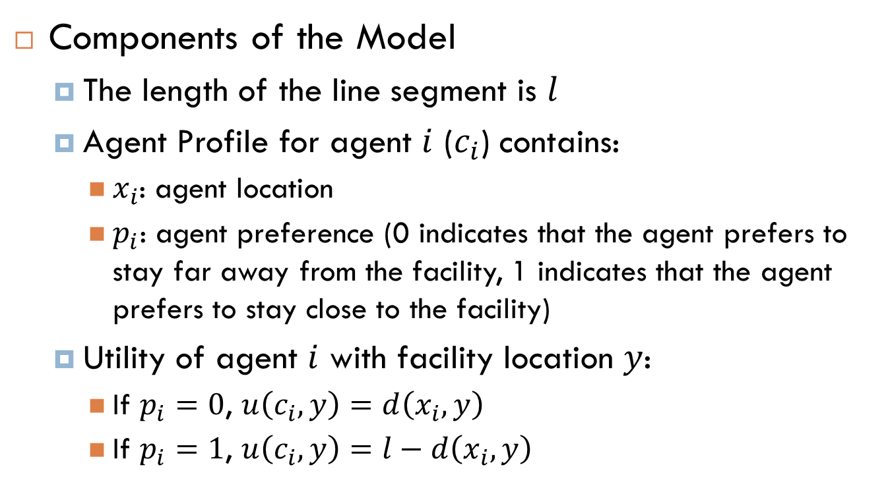
Dual Character Facility Location Game
Components of the Model
The length of the line segment is $l$
Agent Profile for agent $i$ ($c_{i}$) contains:
$x_{i}$: agent location
$p_{i}$: agent preference (0 indicates that the agent prefers to stay far away from the facility, 1 indicates that the agent prefers to stay close to the facility)
Utility of agent $i$ with facility location $y$:
If $p_{i}=0$, $u\left(c_{i},y\right)=d\left(x_{i},y\right)$
If $p_{i}=1$, $u\left(c_{i},y\right)=l−d\left(x_{i},y\right)$
Notes:
In the model, we assume the length of the line segment is l. Each agent i has two attributes, its location xi, and its preference pi. pi could be either 0 or 1 depending on agent’s attitude towards the facility. We define the utility of an agent in different ways for different preferences, but for an agent with any preference, its utility will increase if the facility location becomes better in terms of its own preference.

Slide 34


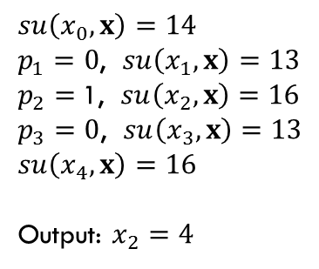
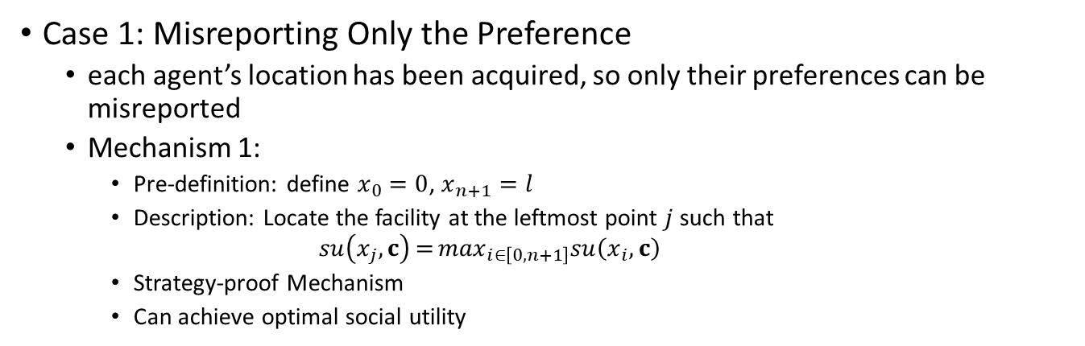




Dual Character Facility Location Game
Case 1: Misreporting Only the Preference
each agent’s location has been acquired, so only their preferences can be misreported
Mechanism 1:
Pre-definition: define $x_{0}=0$, $x_{n+1}=l$
Description: Locate the facility at the leftmost point $j$ such that
$$su\left(x_{j},c\right)={\max_{i∈\left[0,n+1\right]}su\left(x_{i},c\right)}$$
Strategy-proof Mechanism
Can achieve optimal social utility
$$su\left(x_{0}, x\right)=14$$
$p_{1}=0$, $su\left(x_{1}, x\right)=13$
$p_{2}=$1, $su\left(x_{2}, x\right)=16$
$p_{3}=0$, $su\left(x_{3}, x\right)=13$
$$su\left(x_{4}, x\right)=16$$
Output: $x_{2}=4$
$$x_{0}$$
$$x_{1}$$
$$x_{2}$$
$$x_{3}$$
$$x_{4}$$
Notes:
We studied two cases in this model, and the Mechanism 1 is proposed for the first case where each agent can only misreport its preference. We set x0 to be 0 and xn+1 to be 1, and then select the location of the leftmost point among x0 to xn+1 where the social utility can be optimized. For example, for the graph below, we can see the social utility is maximal when the facility is at x2 or x4. But since is x2 < x4, the output is x2. We proved that Mechanism 1 is strategy-proof, and it also gives the optimal social utility.

Slide 35
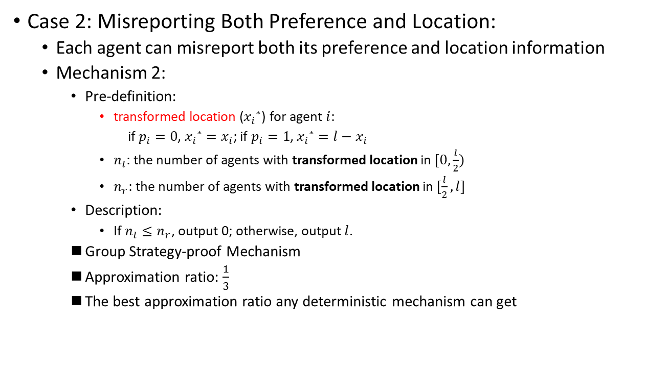
Dual Character Facility Location Game
Case 2: Misreporting Both Preference and Location:
Each agent can misreport both its preference and location information
Mechanism 2:
Pre-definition:
transformed location (${x_{i}}^{∗}$) for agent $i$:
if $p_{i}=0$, ${x_{i}}^{∗}=x_{i}$; if $p_{i}=1$, ${x_{i}}^{∗}=l−x_{i}$
$n_{l}$: the number of agents with transformed location in $[0,\frac{l}{2})$
$n_{r}$: the number of agents with transformed location in $[\frac{l}{2},l]$
Description:
If $n_{l}≤n_{r}$, output 0; otherwise, output $l$.
Group Strategy-proof Mechanism
Approximation ratio: $\frac{1}{3}$
The best approximation ratio any deterministic mechanism can get
Notes:
In the second case, we suppose each agent is able to misreport both preference and location. For this case, we define a new attribute transformed location for each agent, and it is also calculated differently for different types of agents. Then in the Mechanism 2, we count nl and nr with transformed locations of agents, and output either 0 or l by comparing nl and nr. Mechanism 2 is group strategy-proof with an approximation ratio of 1/3.

Slide 36
Season 3: Two Heterogenous Facilities
Two facilities are different
How to characterize this difference?
All agents like one facility but hate the other facility
(Zou and Li, AAMAS 2015)
Each agent can either like F1 or F2 or both the facilities
(Serafino and Ventre, ECAI 2014, AAAI 2015)
(Yuan et al., ECAI 2016)

Slide 37
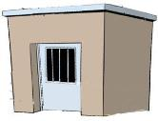




Episode 1: Two-Opposite-Facility Location Game with Limited Distance
A real scenario:
The principal plans to build a police station and a detention house
$$y_{0}$$
$$y_{1}$$
Agents want to keep away from the detention house to avoid security risks
$d(y_{0},y_{1})$ should be limited
Agents want to stay close to the police office for timely rescue in case of emergency
Notes:
Okay, next is the second model we will discuss today. It is two-opposite-facility location game with limited distance and here is a real scenario for it. Imagine the principal plans to build a police office and detention office to maintain the public order. Obviously, all agents want to keep close to police station to get rescue aid in time in case of emergency, but want to keep away from the detention house because of its security risks like prison break. In addition, the principal should also limit the distance between two facilities to guarantee a effective control from police when security incidence happens in detention house.

Slide 38
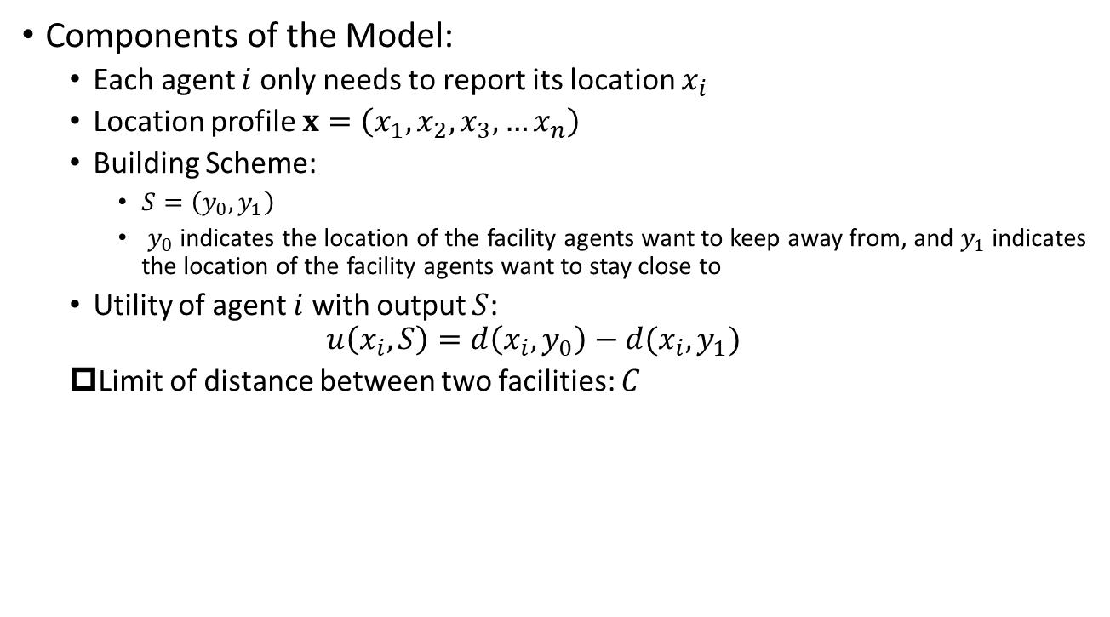
Episode 1: Two-Opposite-Facility Location Game with Limited Distance
Components of the Model:
Each agent $i$ only needs to report its location $x_{i}$
Location profile $x=\left(x_{1},x_{2},x_{3},…x_{n}\right)$
Building Scheme:
$S=\left(y_{0},y_{1}\right)$
$y_{0}$ indicates the location of the facility agents want to keep away from, and $y_{1}$ indicates the location of the facility agents want to stay close to
Utility of agent $i$ with output $S$:
$$u\left(x_{i},S\right)=d\left(x_{i},y_{0}\right)−d(x_{i}, y_{1})$$
Limit of distance between two facilities: $C$
Notes:
In this model, each agent only has its location to report. The output of a mechanism is a building scheme, which contains two locations, y0 and y1. Note that both y0 and y1 have explicit meanings. The utility of an agent is the difference between its distance from y0 and y1.In addition, the distance between two facilities cannot exceed a certain value C.

Slide 39


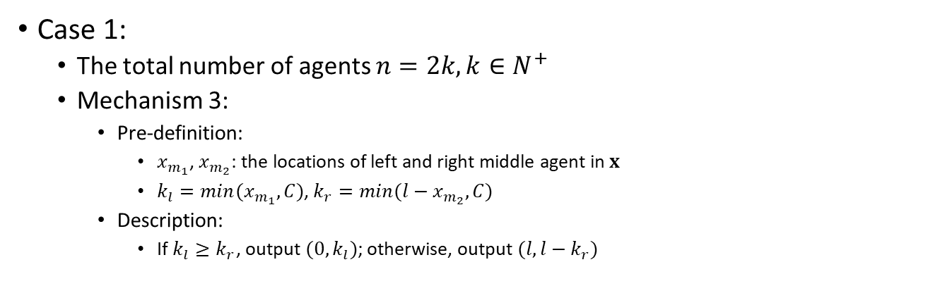




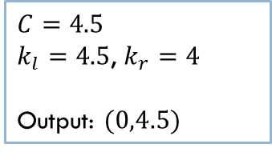


Episode 1: Two-Opposite-Facility Location Game with Limited Distance
Case 1:
The total number of agents $n=2k, k∈N^{+}$
Mechanism 3:
Pre-definition:
$x_{m_{1}}$, $x_{m_{2}}$: the locations of left and right middle agent in $x$
$k_{l}=min(x_{m_{1}},C)$, $k_{r}=min(l−x_{m_{2}},C)$
Description:
If $k_{l}≥k_{r}$, output $(0,k_{l})$; otherwise, output $(l,l−k_{r})$
$$C$$
$$l−C$$
$$C=4.5$$
$k_{l}=4.5$, $k_{r}=4$
Output: $(0,4.5)$
$$x_{m_{1}}$$
$$x_{m_{2}}$$
$$k_{l}$$
$${l−k}_{r}$$
Notes:
We also studied two cases of this model. For the first case where the total number of agents is even, we use xm1 and xm2 to denote left and right middle agents on the line segment, and then we calculate kl and kr by two comparisons with C. The output can be (0,kl) or (l,l-kr) based on the relationship between kl and kr. From the graph below, we can get kl is 4.5 and kr is 4, so the final output is (0,4.5).

Slide 40
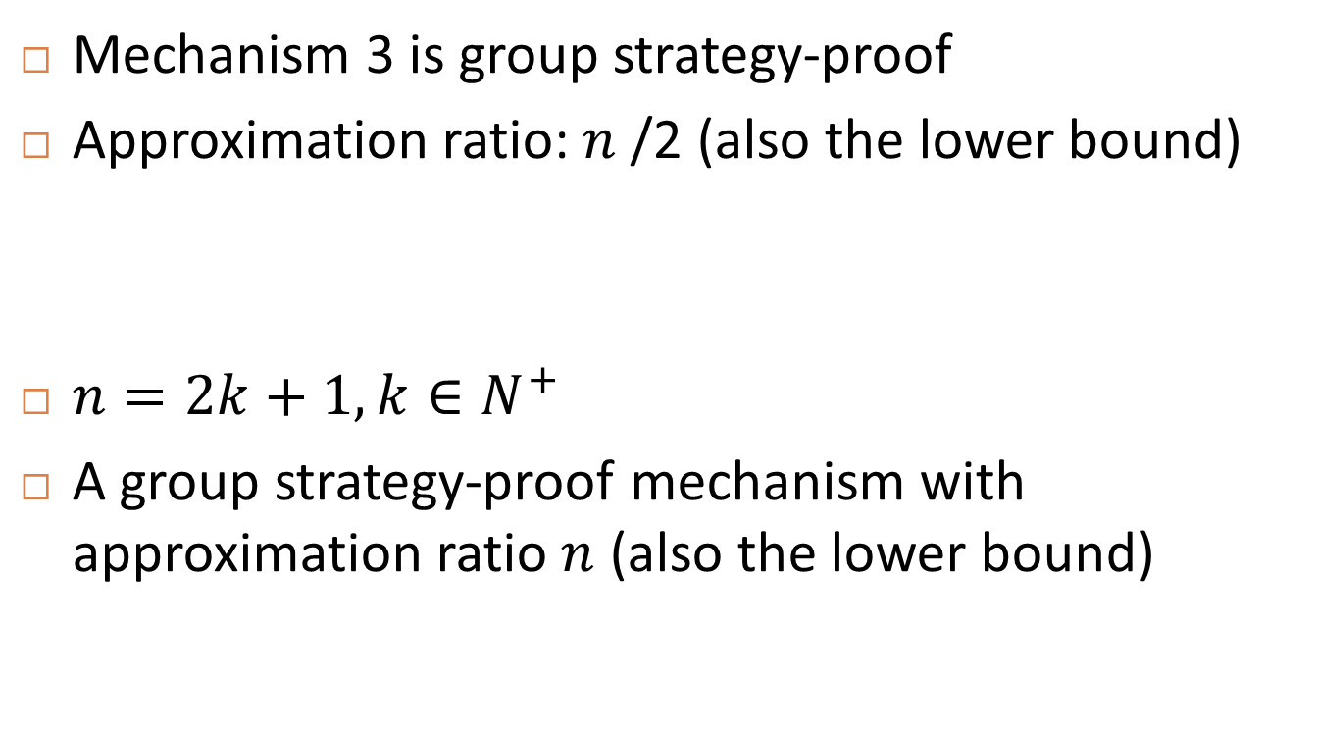
Episode 1: Two-Opposite-Facility Location Game with Limited Distance
Mechanism 3 is group strategy-proof
Approximation ratio: $n$/2 (also the lower bound)
$n=2k+1, k∈N^{+}$
A group strategy-proof mechanism with approximation ratio $n$ (also the lower bound)
Notes:
The Mechanism is proved to be group strategy-proof mechanism with an approximation ratio of 1/k. This is the best ratio any deterministic mechanism can reach.

Slide 41
Episode 2: Agents like different facilities
Proposed by Carmine Ventre’s group
There are two facilities: F1, F2
Agents may only like F1, or only like F2 or like both
The cost of agents
the sum of distances to facilities she likes
Facilities can only be built on the positions of agents (discrete)
Notes:
In addition, we give another mechanism when the total number of agents is odd. The Mechanism 4 is really similar to the mechanism for the even case, except that we get kl and kr with xm, which is the location of the middle agent. It is also a group strategy-proof mechanism. Its approximation ratio is 1/2k-1, which is also the best ratio for all deterministic mechanisms.

Slide 42
Episode 3: Agents like different facilities but…
We change the cost of agents
Agents’ cost can be
Sum distance (Carmine’s work)
Min distance (Our work in ECAI 2016)
Max distance (Our work in ECAI 2016)
Real world examples for Min and Max
Min: Two stops for two bus routes will be built on a line
Max: Again two bus routes but this time back home

Slide 43
Results
The Min variant under Maximum Cost Objective
Lower bound: 4/3
Upper bound: A 2-approximation mechanism
The Min variant under Social Cost Objective
Lower bound: 2
Upper bound: A 3-approximation mechanism
The Max variant under Maximum Cost Objective
Lower bound &Upper bound: An optimal mechanism
The Max variant under Social Cost Objective
Upper bound: A 2-approximation mechanism

Slide 44





Episode 4: Fractional Preference
Different percentage of time devoted to different facilities with similar functionalities
(Our work in AAAI 2018)
Only can choose one of them or both of them ?
Convenient Store
Supermarket
Clinic
Hospital

Slide 45
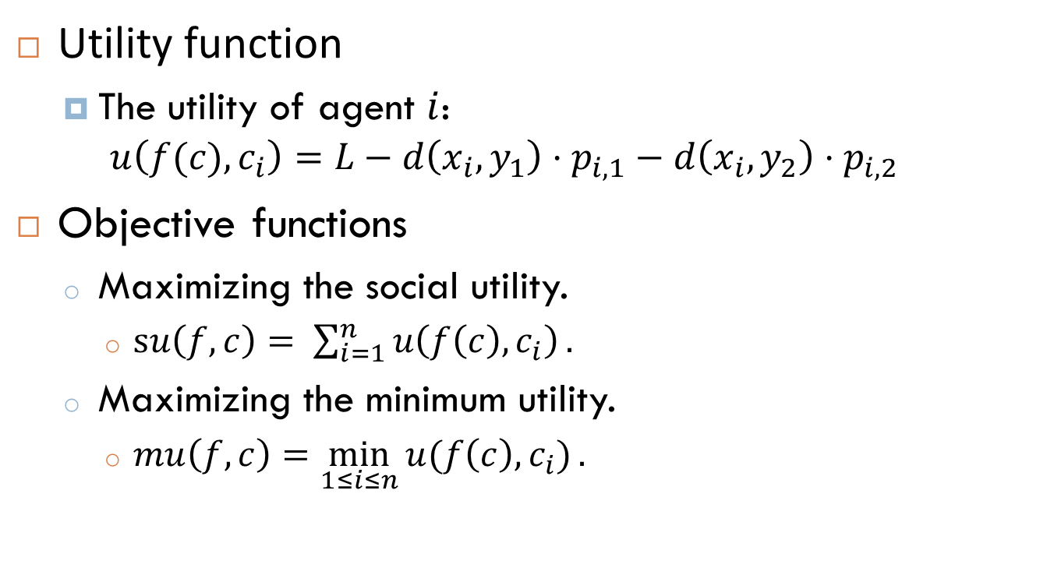
Episode 4: Fractional Preference
Utility function
The utility of agent $i$: $u\left(f(c),c_{i}\right)=L−d\left(x_{i},y_{1}\right)⋅p_{i,1}−d\left(x_{i}, y_{2}\right)⋅p_{i,2}$
Objective functions
Maximizing the social utility.
$su\left(f,c\right)= \sum_{i=1}^{n}{u\left(f\left(c\right), c_{i}\right)}.$
Maximizing the minimum utility.
$mu\left(f,c\right)=\min_{1≤i≤n}{u(f\left(c\right), c_{i})}.$

Slide 46
Episode 4: Fractional Preference
Objective | Restrict the Power of Misreport
 | Location Only | Preference Only | No Restriction
Social Utility | Optimal | Upper Bound: 2 Lower Bound: 1.06 | Upper Bound: 4 Rand Upper Bound: 2 Lower Bound: 1.06 Rand Lower Bound: 1.06
Min Utility | Optimal | Upper Bound: 2 | Upper Bound: 2 Lower Bound: 1.5

Slide 47
Season 4: Change Objectives
Objectives:
Social Happyness (Mei, Li, Ye and Zhang, AAMAS 2016)
1 - Actual/Worst
Minimax Envy (Cai, Filos-Ratsikas and Tang, IJCAI 2016)
minimize (Max Cost – Min cost)

Slide 48
Season 5: Adding Constraints
Constraints among agents (how agents affect each other)
Externality (AAMAS 2019)
Constraints among facilities
Maximum Distance (AAMAS 2015)
Minimum Distance (AAMAS 2019)
Exact distance (Activity Scheduling, AAMAS 2019)
Combining the two roles (AAMAS 2019)
Communities

Slide 49
Works done by other groups
Characterization
Capacity Constraint
Other cost functions (SoS, Manhattan)
Falsename manipulation
Dynamic facilities/Facility relocation
Candidate locations (discrete)
Distortion
…

Slide 50
Future Work (Season X?)
There are always new problems worth studying
Existing gaps in approximation ratios are always worth closing
Other concepts in algorithmic game theory and social choice theory may inject new insights into the facility location games
Fairness (IJCAI 2022, AAAI 2024)
Cheating facilities (IJCAI 2020)
Altruism (AAAI 2024)
…

